Slide 1

Green University of Bangladesh Department of Computer Science and Engineering (CSE)
Faculty of Sciences and Engineering Semester: (Fall, Year:2022), B.Sc. in CSE (Day)
LAB PROJECT PROPOSAL
Course Title: Structured Programming Lab
Course Code: CSE 104 Section: DC
Student Details
Name |  | ID
1. | Md. Sohan Millat Sakib | 222902036
2.
3.
Lab Date Submission Date
Course Teacher’s Name
01-12-2022
: _ _ _ _ _ _ _ _ _ _ _ _ _ _ _ _ _ _ _ _ _ _ _ _
: _ _ _ _ _ _ _ _ _ _ _ _ _ _ _ _ _ _ _ _ _ _ _ _
: _ _ _ _ _ _ _ _ _ _ _ _ _ _ _ _ _ _ _ _ _ _ _ _
06-12-2022
JARIN TASNIM TONVI
[For Teachers use only: Don’t Write Anything inside this box]
Project Proposal Status
Marks: ………………………………… Signature: .....................
Comments: .............................................. Date: ..............................

Slide 2
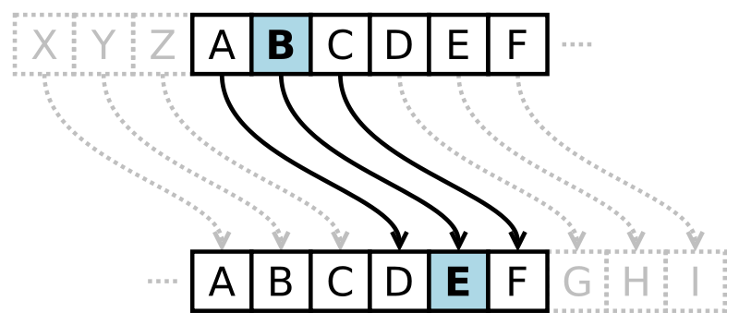
Title: Data Encryption by a key. (Caesar cipher)
Caesar cipher is a simple method of encoding messages. Caesar ciphers use a substitution method where letters in the alphabet are shifted by some fixed number of spaces to yield an encoding alphabet.
It is a type of substitution cipher in which each letter in the plaintext is replaced by a letter some fixed number of positions down the alphabet. For example, with a left shift of 3, D would be replaced by A, E would become B, and so on.
PROBLEM DOMAIN & MOTIVATIONS:
This is a simple Encryption methode and anyone can Encrypt their message using this program.
We can develop a messenger software by using this algorithm which encrypt a massage before sent a message.

Slide 3
OBJECTIVES/AIMS:
In this age encryption is an important issue in our life. Because there have many kinds of messages that we want to hide from another. This is why encryption methods are invented. At first, Encryption is used by kings for communicating. The aims of the encryption method are written below.
We can encrypt our data by using a simple algorithm.
Hide data from unwanted person.
TOOLS & TECHNOLOGIES:
I use C Language to write this program. I use Codeblocks to write this program & use GCC-Compiler to compile this program.
CONCLUSION:
Every technology has some good and bad side. Like others it has some good and bad side. The good side of this program is any one can Encrypt their message easily. And the bad side of this program is any one can decrypt to the main message by maximum 26 time tring. This is a small project and by this program a student can learn how an encryption Method are working.

